Slide 1
Usable Machine Learning I

Slide 2
Usable Machine Learning
Difficulties with machine learning
Understand what is going on
Control what is going on
Potential cost to user
Corrections
Features
[Labels]

Slide 3
Understanding what is going on: Forming Mental Models
How does a system know I am addressing it?
How do I know a system is attending to me?
When I issue a command/action, how does the system know what it relates to?
How do I know that the system correctly understands my command and correctly executes my intended action?
Belloti et al., CHI 2002 ‘Making Sense of Sensing’

Slide 4
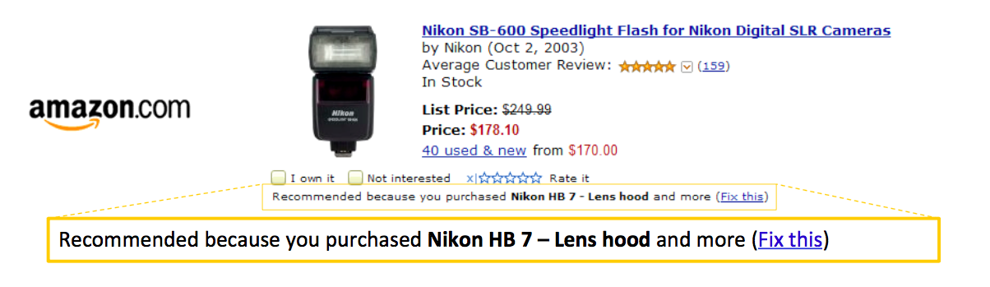
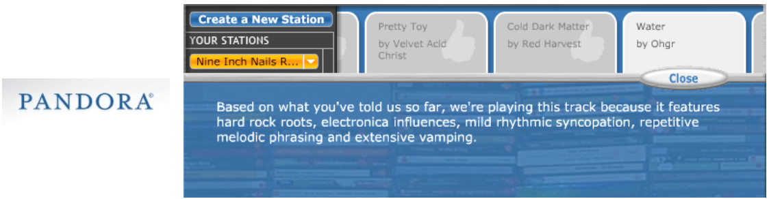
Discuss:
Notes:
How does a system know I am addressing it?
How do I know a system is attending to me?
When I issue a command/action, how does the system know what it relates to?
How do I know that the system correctly understands my command and correctly executes my intended action?
What did the system do?
What if I do W, what will the system do?
Why did the system do X?
Why did the system not do Y
How do I get the system to do Z?

Slide 5
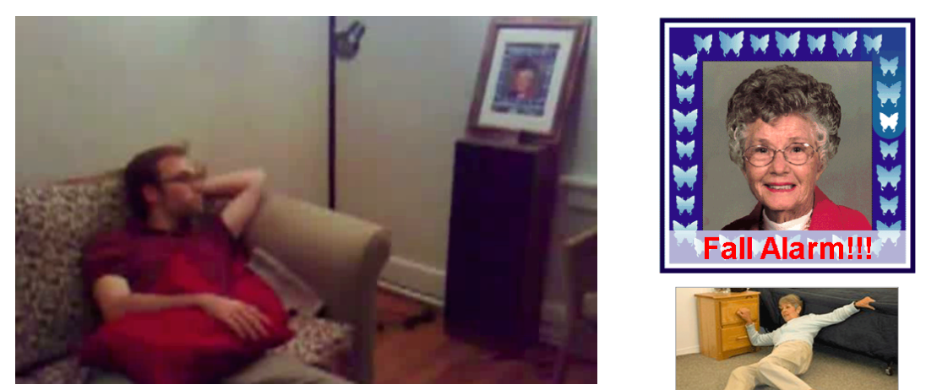
Accident Identification: What would you want to know?
Notes:
Did she fracture any bones in the fall? How long ago did this happen?
If she didn’t fall, How does the system detect falls?

Slide 6
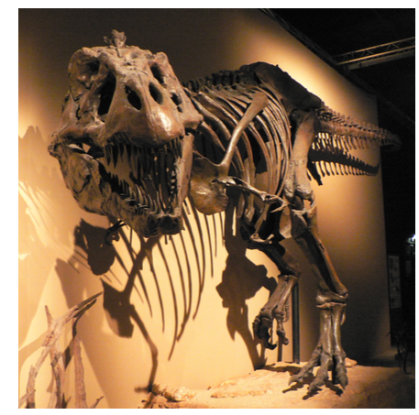
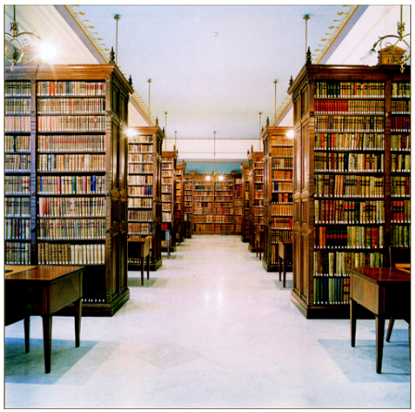
Known Preference

Slide 7
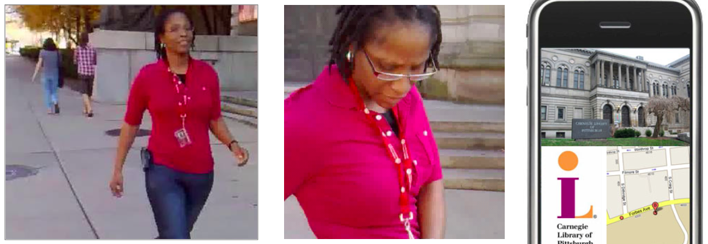
Wrong location-based recommendation
Notes:
Why did it not tell me about the Museum? How does it determine my loca0on?
Providing explana7ons to these ques7ons can make Intelligent systems Intelligible

Slide 8
Types of Feedback
Feedback: crucial to user’s understanding of how a system works and helping guide future action
What did the system do?
What if I do W, what will the system do?
Why did the system do X?
Why did the system not do Y
How do I get the system to do Z?

Slide 9
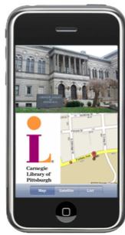
Best Feedback Depends on Circumstance
Did she fracture any bones in the fall?
How long ago did this happen? How does the system detect falls?
Why did it not tell me about the Museum? How does it determine my loca0on?
Notes:
Could add further slides from Dey-intelligibility.pdf
Appropriateness; criticality; goal-supportive; externalities should all be considered in designing for this.

Slide 10
Usable Machine Learning
Difficulties with machine learning
Understand what is going on
Control what is going on [discuss]
Potential cost to user
Corrections
Features
[Labels]

Slide 11
Usable Machine Learning
Difficulties with machine learning
Understand what is going on
Control what is going on [discuss]
Potential cost to user
Corrections
Features
[Labels]

Slide 12
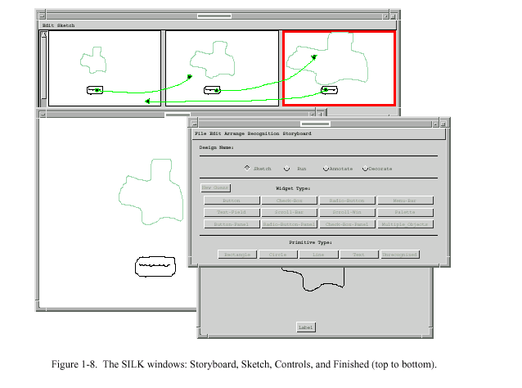
SILK (Landay, Myers 1996)
Notes:
Magnify mediator?

Slide 13
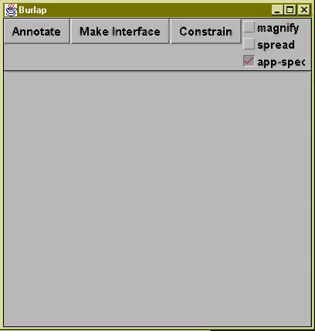
Burlap

Slide 14
Investigations of Mediation Techniques
Multimodal correction
Suhm (98)
McGee et al (98)
Pen Correction
Huerst, Yang & Waibel (98)
Speech Correction
Ainsworth & Pratt (92)
Baber & Hone (93)
Mixed-initiative
Horvitz
Many Others…

Slide 15
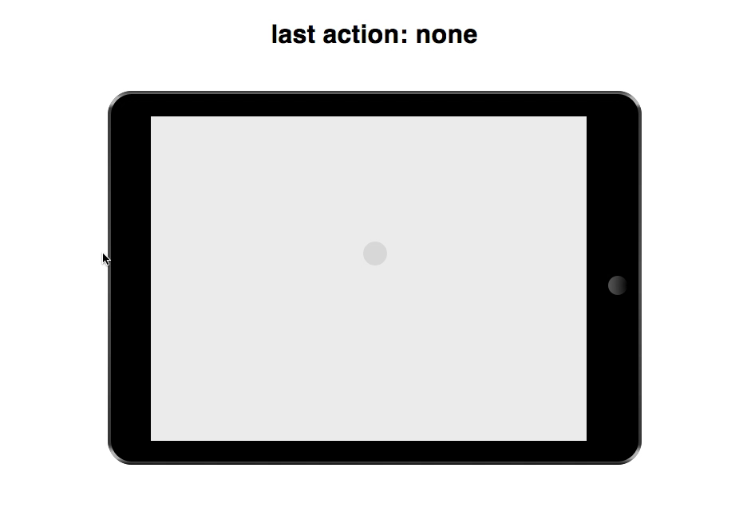
Types of Uncertainty/Errors
Recognition (interpretation)
Notes:
Mediation
dialogue between user and computer
used for resolving uncertainty

Slide 16
Types of Uncertainty/Errors
Recognition (interpretation)
Target (receiver of input)
Notes:
Mediation
dialogue between user and computer
used for resolving uncertainty

Slide 17
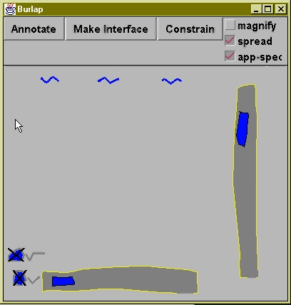
Types of Uncertainty/Errors
Recognition (interpretation)
Target (receiver of input)
Rejection (missed input)
Notes:
Probably more…

Slide 18
How do people address uncertainty and avoid / correct error?
Contextual Interviews with 7 Practitioners
Interview experts in human direction
Conducted standard interviews and observation of practice, as appropriate
Film & Theatre Directors, Child Photographer
Golf Instructor, Aikido Sensei
911 Phone Operator, Telephone Triage Nurse
Notes:
Wanted to start with systems, but understanding people is equally important….
Reviewed work & interviewed people
Our seven interviewees span a number of disciplines, covering a wide array of direction techniques and domains. In the end, we interviewed [list folks].
performance folks – illicit specific emotional and physical responses.
sports instructors – teach, monitor, and guide new physical actions
Mention telephone operators function over a reduced sensor channel.

Slide 19
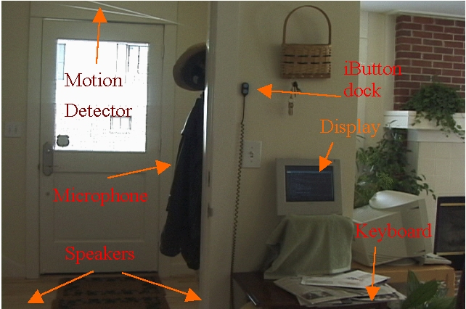
Design Guidelines
How to handle mediation:
Distributed, multi-user settings
Set up interactions across time and space

Slide 20
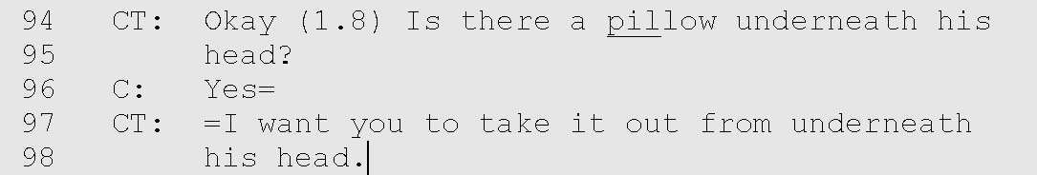
Anticipation
Anticipate common errors before they happen. Actively seek out and address problems before they disrupt interaction.

Slide 21
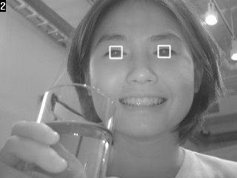
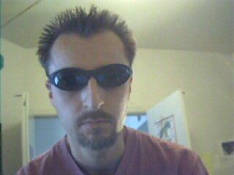
Anticipation
Anticipate common errors before they happen. Actively seek out and address problems before they disrupt interaction.

Slide 22
Consequences
Explain the consequences, both positive and negative, of particular actions.
Notes:
This allows participants to understand why they are being asked to do particular actions.
Example: Dialog box asking ‘do you really want to delete this file?

Slide 23
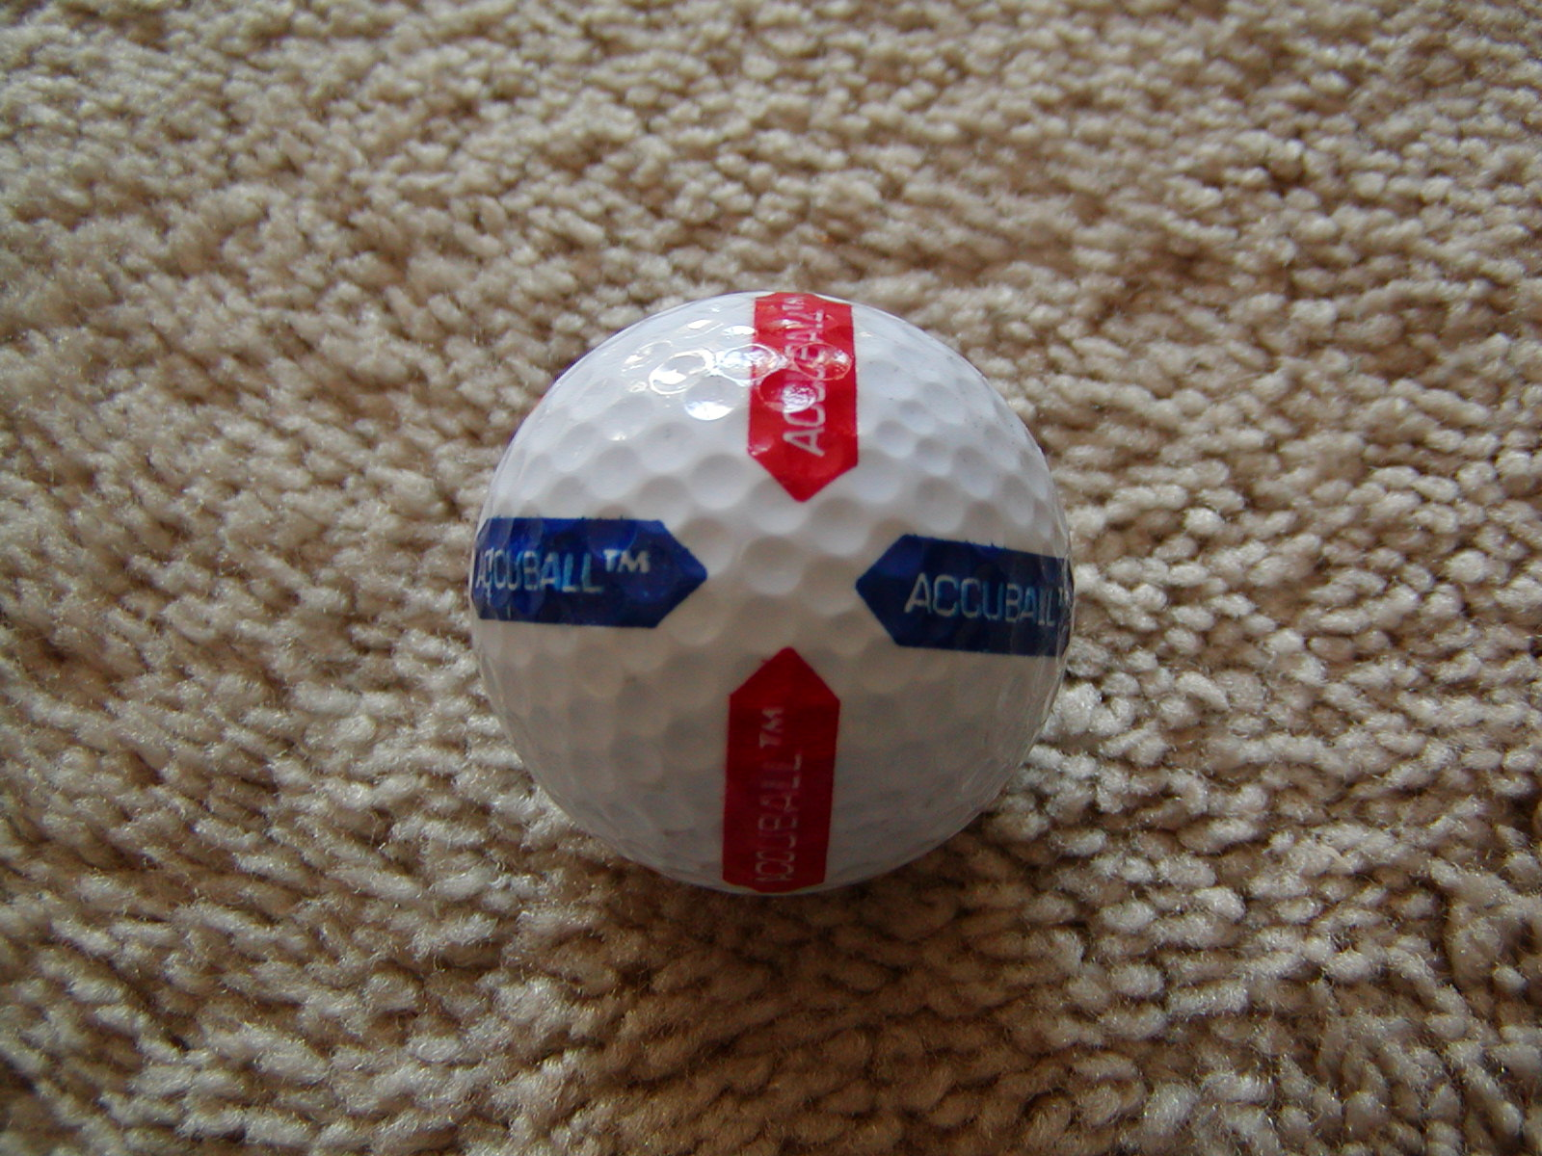
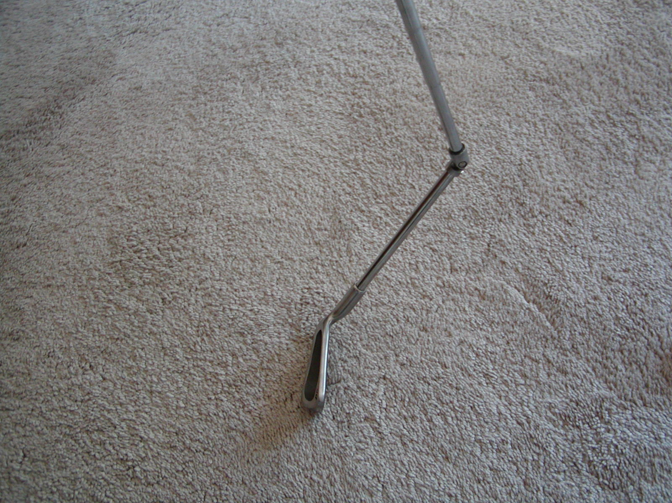
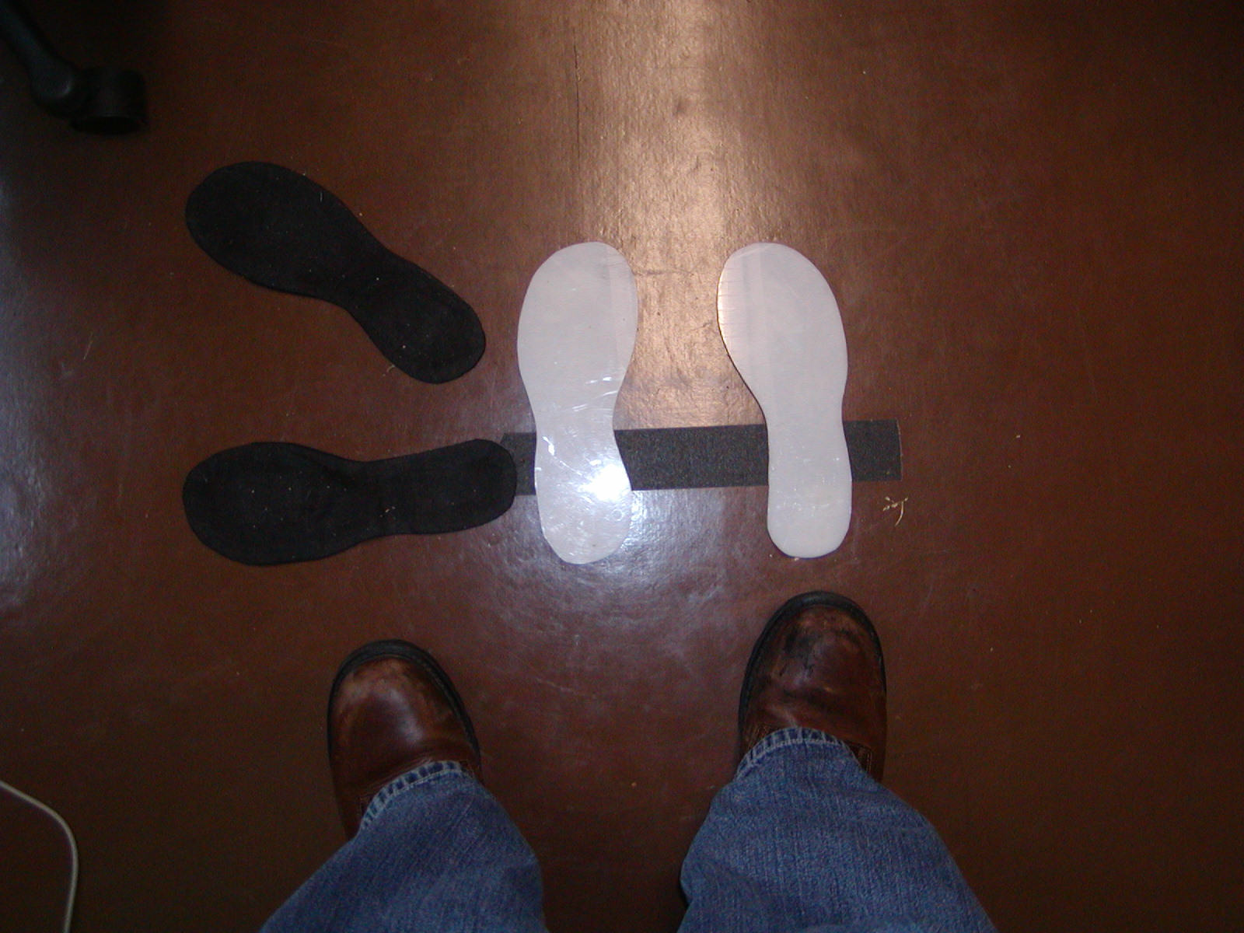
External Aids
Use physical props or other external aids to guide actions and provide feedback.

Slide 24
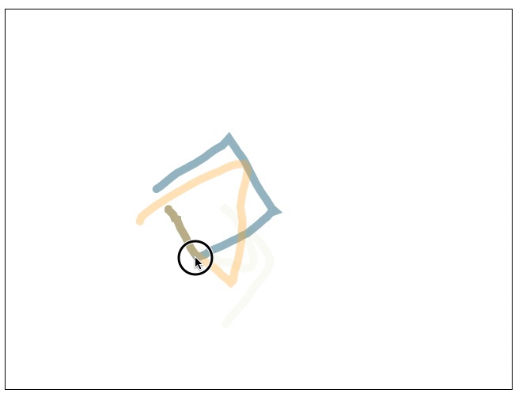
Example: Octopocus [Bau UIST’08]

Slide 25
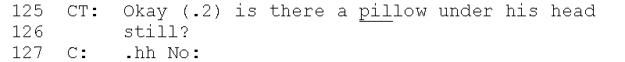
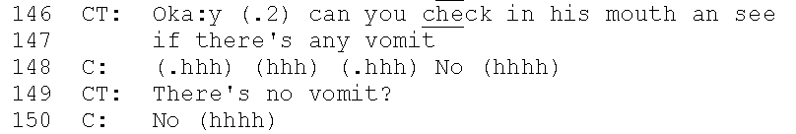
Confirmation
Explicitly query the subject to ensure they are in the expected state.
Notes:
Two reasons to do this
The first reason is to establish grounding. Even a simple ‘yes’/’no’ recognizer on a computer could be used to determine the participant’s state.
The second reason is to give the participant a chance to review the direction, and repeat it themselves, fostering learning and memory.
911 operators continually use confirmation, confirming every instruction they give to the user. Often by phrasing instructions as questions for the caller to answer. Here, the triage nurse describes how she confirms her directions with a caller.

Slide 26
Example: Showing tentative Results

Slide 27
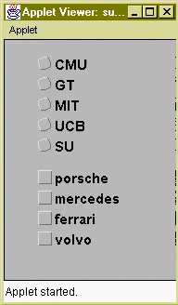
Freshness
Avoid repeating utterances, even when giving an instruction nearly identical to a previous one.

Slide 28
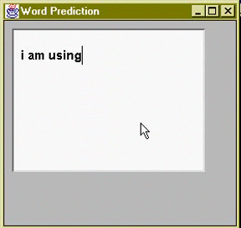
Progressive Assistance
Provide “successively more informative error messages which consider the probable context of misunderstanding” [Yankelovich95].
28
Notes:
the next strategy is progressive assistance, a term taken from Yankelovich et al’s work on designing speech interfaces. For example, telling a user in an ActiveCapture scenario to “Scream louder” is much more useful than just telling them to “Scream Again”. In some cases the system might not be able to determine the exact cause for a problem, in which case progressive assistance may just be the computer’s admission that it can’t determine the problem, but still suggest possible causes to consider.

Slide 29
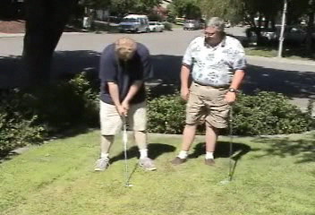
Method Shifts
In response to problems, vary forms of direction between Tell, Show, and Make.
Notes:
Direction can varying from giving instructions or TELLing the subject what to do, providing a demonstration or SHOWing the subject what to do, and MAKEing the subject do something, either by physical manipulation or through stimulus-response.
In this clip, the gold instructor handles error by switching from giving Nathan instructions to demonstrating proper technique.

Slide 30

Modality Shifts
When a particular direction approach repeatedly fails, switch or augment the modalities of communication, e.g., use visual rather than auditory cues.
Notes:
You can use multiple modalities at once. For example, in the clip I showed earlier, the Aikido instructor both physically demonstrated a roll, but also talked about each step as he was doing it.

Slide 31
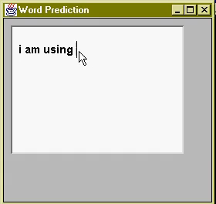
Shifting from writing to selection
Problem: The correct choice isn’t present
Example: word-prediction
Solution: Allow the user to add choices

Slide 32
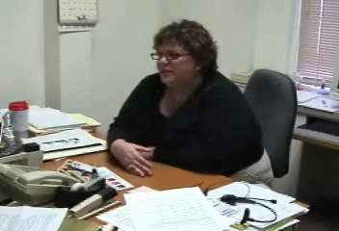
Level of Discourse
Simplify vocabulary and language when people have difficulty understanding.
Notes:
In this clip, the triage nurse describes how she changed level of discourse with a caller while discussing a child’s runny nose.

Slide 33
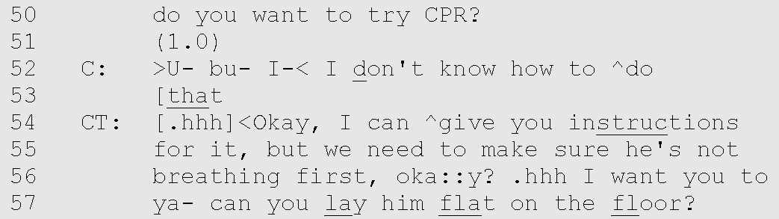
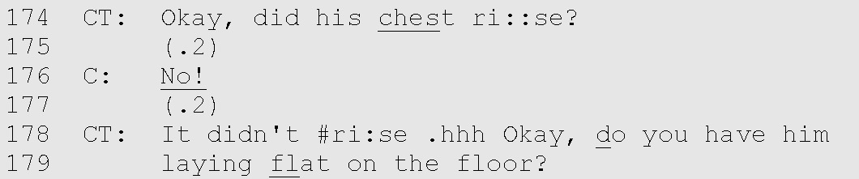
Backtracking
When grounding is lost, backtrack to the last state of mutual understanding.
Notes:
Mention tie to confirmation.

Slide 34
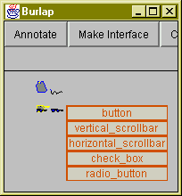
Example: Repetition

Slide 35
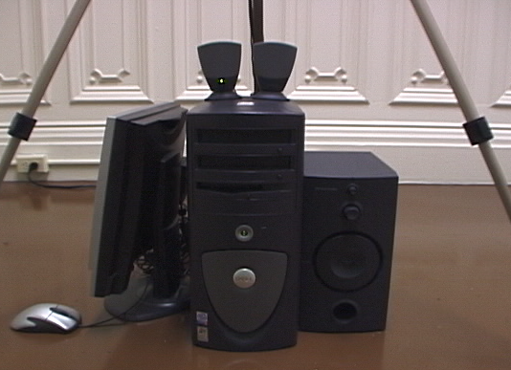
Graceful Failure
When all else fails, provide natural exits from the interaction.
JUMP!
Notes:
The heart of graceful failure is to recognize over-repetition and handle it accordingly. The problem may be that the user is not meeting programmed requirements, the system is malfunctioning, or there is some important context the system can not capture.
For example, an ActiveCapture scenario which instructs people to jump may be largely unsuccessful with injured or disabled users. The system design must recognize this possibility, by providing natural exits in the face of repeated failure.

Slide 36
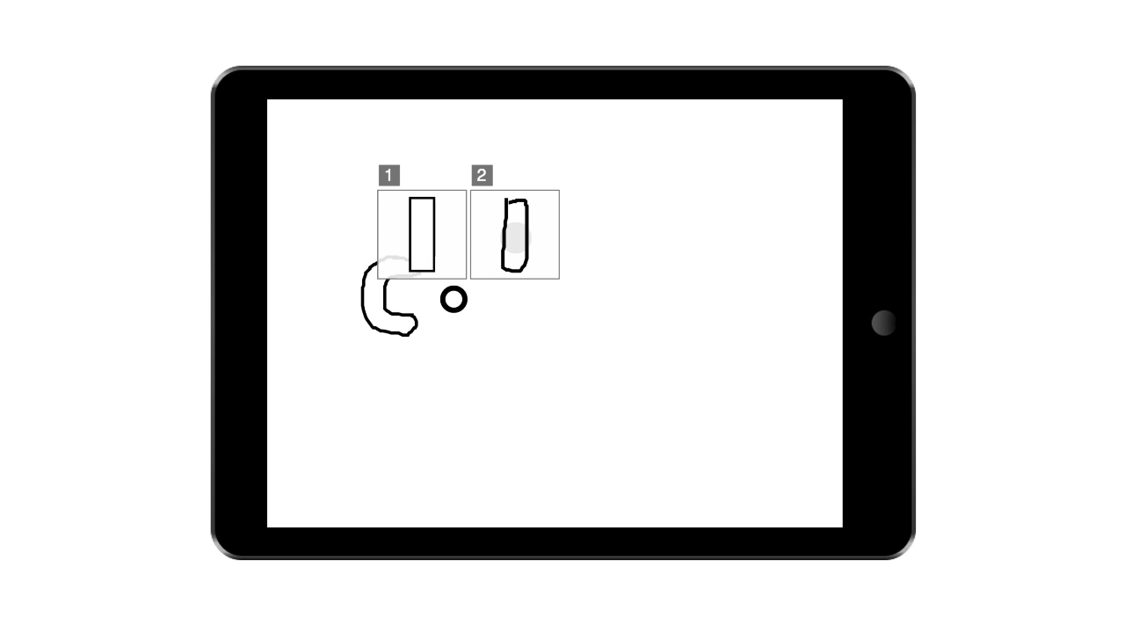
Video Demonstrations

Slide 37
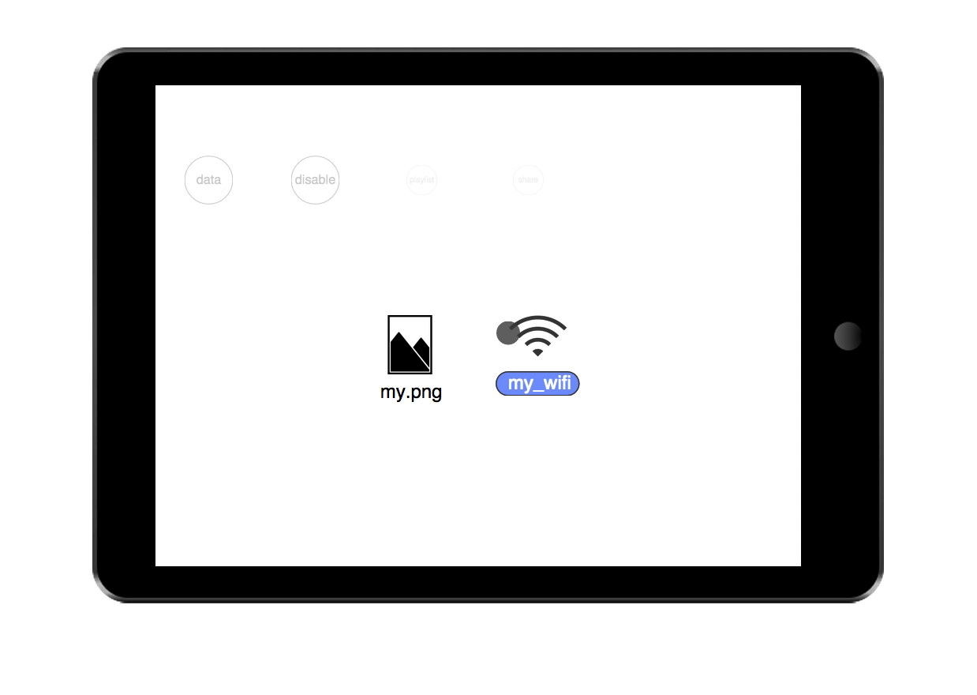
Notes:
In this application we can drag icons to targets to perform different actions on them.
The probabilistic version of this interface attempts to guess which action is going to be performed and adjust likelihood accordingly.
Here we adjust the scale of the targets according to likelihood, while adjusting opacity of icons.
This shows off another feature we have, which is that we can configure which feedback techniques to apply to which interactors by wrapping feedback into a meta-feedback object which changes what feedback to use based on interactor id, context, etc.

Slide 38
